Slide 1
Modules Session 3
Course : COMP6056
Effective Period : September 2021

Slide 2
Sub Topics
Introduction to Modules
Defining and calling a module
Local Variables
Passing arguments
Global Variables and Global constan

Slide 3
These slides have been adapted from: Gaddis, T. (2019). Starting Out with Programming Logic and Design 5^{th.} ISBN: 978-0-13-480115-5 Chapter 3
Acknowledgement

Slide 4
Learning Objectives
At the end of this lecture, students are able to:
LO1: To explain the uses and benefits of module
LO2: To write pseudo-code to solve simple problem with the use of modules

Slide 5
Introduction to Modules
What is a Module?
A module is a group of statements that exists within a program for the purpose of performing a specific task.
Most programs are large enough to be broken down into several subtasks.
Divide and conquer: It’s easier to tackle smaller tasks individually
Gaddis, T., Starting Out With Programming Logic and Design, 5 ed, ISBN: 978-0-13-480115-5

Slide 6
Introduction to Modules
Gaddis, T., Starting Out With Programming Logic and Design, 5 ed, ISBN: 978-0-13-480115-5

Slide 7
Introduction to Modules
5 benefits of using modules
Simpler code
Small modules easier to read than one large one
Code reuse
Can call modules many times
Better testing
Test separate and isolate then fix errors
Faster development
Reuse common tasks
Easier facilitation of teamwork
Share the workload
Gaddis, T., Starting Out With Programming Logic and Design, 5 ed, ISBN: 978-0-13-480115-5

Slide 8
Defining and Calling a Module
The code for a module is known as a module definition.
Module showMessage()
Display “Hello world.”
End Module
To execute the module, you write a statement that calls it.
Call showMessage()
Gaddis, T., Starting Out With Programming Logic and Design, 5 ed, ISBN: 978-0-13-480115-5

Slide 9
Defining and Calling a Module
A module’s name should be descriptive enough so that anyone reading the code can guess what the module does.
No spaces in a module name.
No punctuation.
Cannot begin with a number.
Gaddis, T., Starting Out With Programming Logic and Design, 5 ed, ISBN: 978-0-13-480115-5

Slide 10
Defining and Calling a Module
Definition contains two parts
A header
The starting point of the module
A body
The statements within a module
Module name( )
Statement
Statement
Etc.
End Module
Gaddis, T., Starting Out With Programming Logic and Design, 5 ed, ISBN: 978-0-13-480115-5

Slide 11
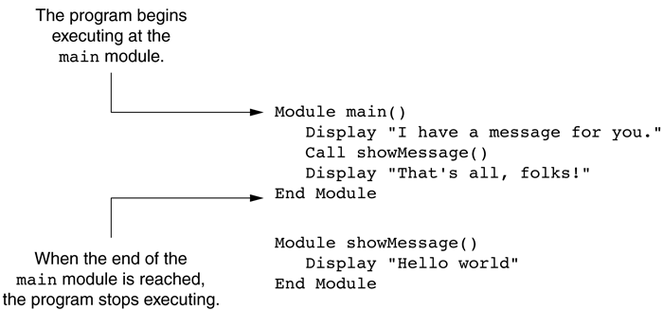
Defining and Calling a Module
A call must be made to the module in order for the statements in the body to execute.
The main module
Gaddis, T., Starting Out With Programming Logic and Design, 5 ed, ISBN: 978-0-13-480115-5

Slide 12
Defining and Calling a Module
A top-down design is used to break down an algorithm into modules by the following steps:
The overall task is broken down into a series of subtasks.
Each of the subtasks is repeatedly examined to determine if it can be further broken down.
Each subtask is coded.
Gaddis, T., Starting Out With Programming Logic and Design, 5 ed, ISBN: 978-0-13-480115-5

Slide 13
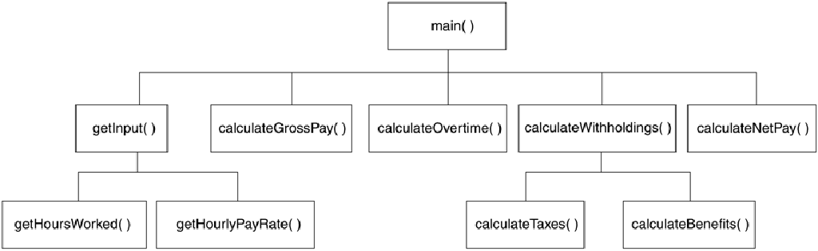
Defining and Calling a Module
A hierarchy chart gives a visual representation of the relationship between modules.
The details of the program are excluded.
A hierarchy chart
Gaddis, T., Starting Out With Programming Logic and Design, 5 ed, ISBN: 978-0-13-480115-5

Slide 14
Local Variables
A local variable is declared inside a module and cannot be accessed by statements that are outside the module.
Scope describes the part of the program in which a variable can be accessed.
Variables with the same scope must have different names.
Gaddis, T., Starting Out With Programming Logic and Design, 5 ed, ISBN: 978-0-13-480115-5

Slide 15
Passing Arguments to Modules
Sometimes, one or more pieces of data need to be sent to a module.
An argument is any piece of data that is passed into a module when the module is called.
A parameter is a variable that receives an argument that is passed into a module.
The argument and the receiving parameter variable must be of the same data type.
Multiple arguments can be passed sequentially into a parameter list.
Gaddis, T., Starting Out With Programming Logic and Design, 5 ed, ISBN: 978-0-13-480115-5

Slide 16
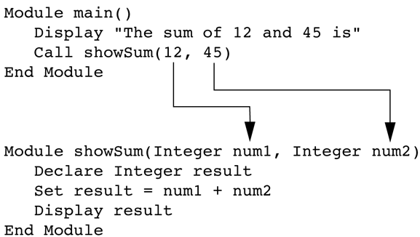
Passing Arguments to Modules
Two arguments passed into two parameters
Gaddis, T., Starting Out With Programming Logic and Design, 5 ed, ISBN: 978-0-13-480115-5

Slide 17
Passing Arguments to Modules
Pass by Value vs. Pass by Reference
Pass by Value means that only a copy of the argument’s value is passed into the module.
One-directional communication: Calling module can only communicate with the called module.
Pass by Reference means that the argument is passed into a reference variable.
Two-way communication: Calling module can communicate with called module; and called module can modify the value of the argument.
Gaddis, T., Starting Out With Programming Logic and Design, 5 ed, ISBN: 978-0-13-480115-5

Slide 18
Global Variables & Global Constants
A global variable is accessible to all modules.
Should be avoided because:
They make debugging difficult
Making the module dependent on global variables makes it hard to reuse module in other programs
They make a program hard to understand
Gaddis, T., Starting Out With Programming Logic and Design, 5 ed, ISBN: 978-0-13-480115-5

Slide 19
Global Variables & Global Constants
A global constant is a named constant that is available to every module in the program.
Since a program cannot modify the value of a constant, these are safer than global variables.
Gaddis, T., Starting Out With Programming Logic and Design, 5 ed, ISBN: 978-0-13-480115-5

Slide 20
References
Gaddis, T. (2019). Starting Out with Programming Logic and Design 5th. ISBN: 978-0-13-480115-5

